Slide 1
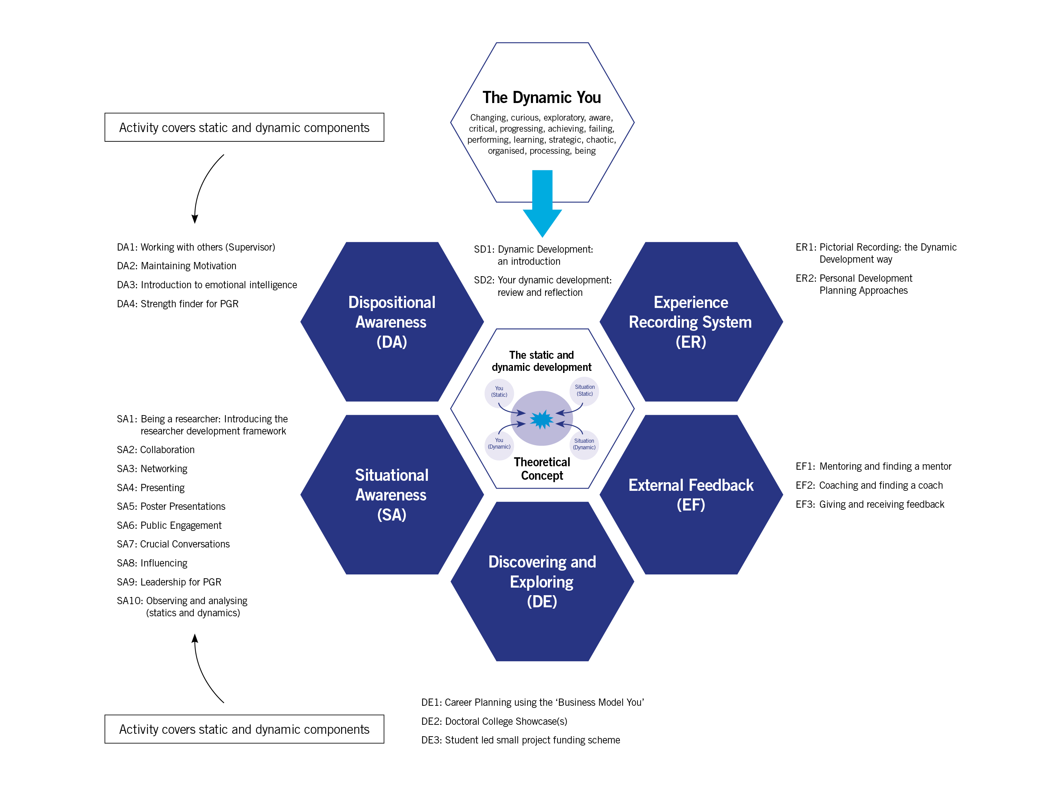
Framing a programme the Dynamic Development way
In which hexagon would one of your activities predominantly sit?
Page 24
Graphic illustration uses the OD&PL department Postgraduate Research programme at the University of Leeds

Slide 2
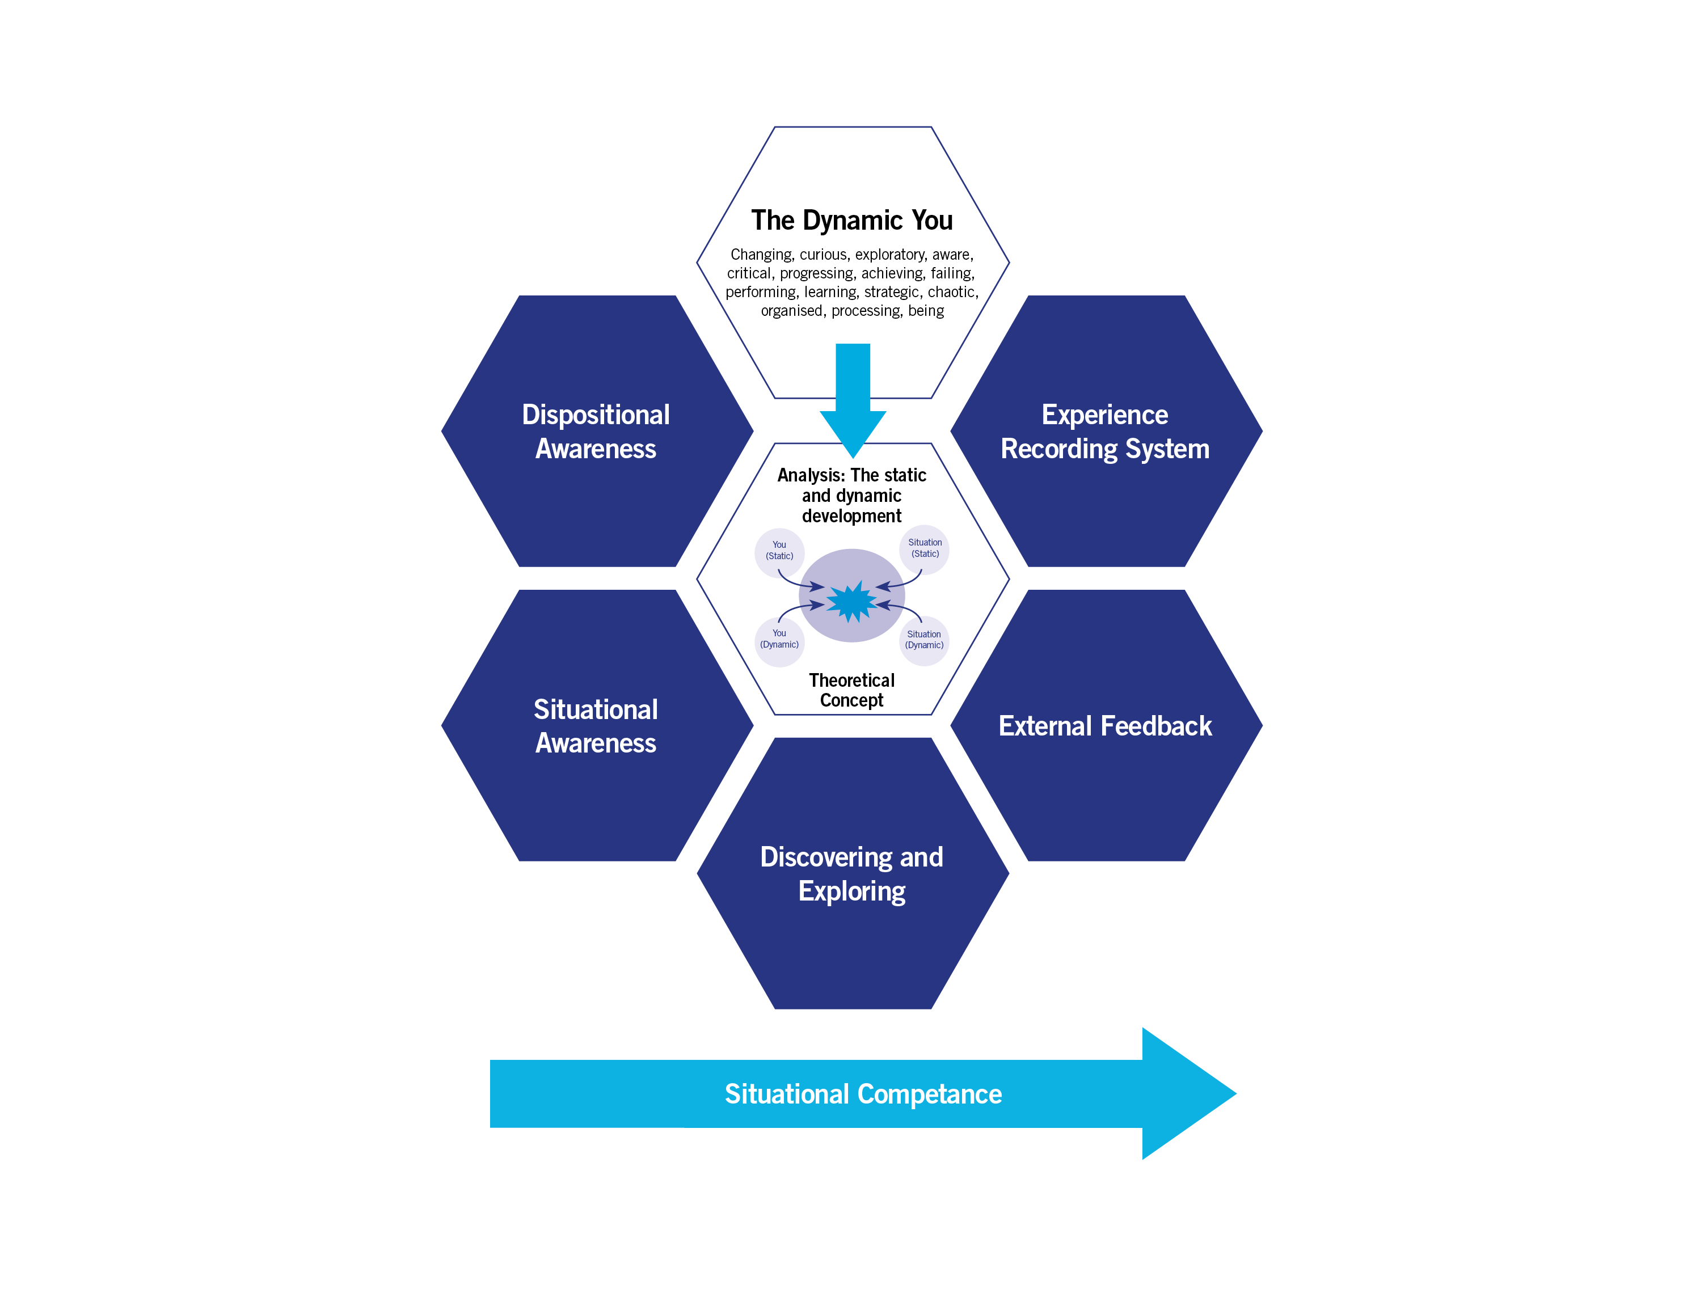
Framing a programme the Dynamic Development way
In which hexagon would one of your activities predominantly sit?

